Slide 1
Group Contract
University of Illinois Urbana-Champaign // Insper

Slide 2

Our Topics
We are discussing music and entertainment in the US and Brazil.
How they influence each other
We begin by discussing how each culture’s music influences the other.
Pop Music and Global Influence
Discussing pop stars who left a lasting impact on both cultures, the current stars who dominate the charts, and how pop music connects the cultures
Comparison of Genres
Comparing Genres between the US and Brazil, how they develop differently in each culture

Slide 3
Outline & Work Breakup
Influence of American Music in Brazil (Sylvain)
Influence of Brazilian Music in America (Sylvain)
Pop Music (Robert)
Rock: US vs Brazil (Robert)
Forro vs Swing (Fernanda)
Funk: US vs Brazil (Fernanda)
Jazz vs Bossa Nova (Sylvain)
Club Music: US vs Brazil (Fred)
Conclusion (Fred)

Slide 4
Schedule Feb 12: Dividing up work, defining goals Offline – Work on our individual slides Feb 20: Meet (10am CST), Review slides and Recommend improvements Offline – Work on improvements, practice presentation Feb 27: Meet (10am CST), Practice Presentation
Agreed to meet Fridays, 10am cST/1pm

Slide 5
Problem solving
ATTENDANCE & RESPONSABILITIES
If someone is not present at one of the scheduled meetings without informing the other members, or if someone does not complete their part of the work before the next meeting, we will first discuss it together to understand why this situation occurred. Then, we will try to determine the best solution according to the circumstances.
OUR APPROACH
We will not have a strict policy regarding these situations, but instead we will adapt the solution depending on each case after discussing it in a meeting.
TEAM COMMUNICATION
To ensure open and constructive discussions, everyone is encouraged to speak freely and share their point of view.
DECISION-MAKING PROCESS
If we disagree about the quality of the work or the strategy to achieve our goal, we will organize an exceptional meeting to talk about it, present the pros and cons of each point of view, and then proceed to a vote to decide which direction to take.

Slide 6
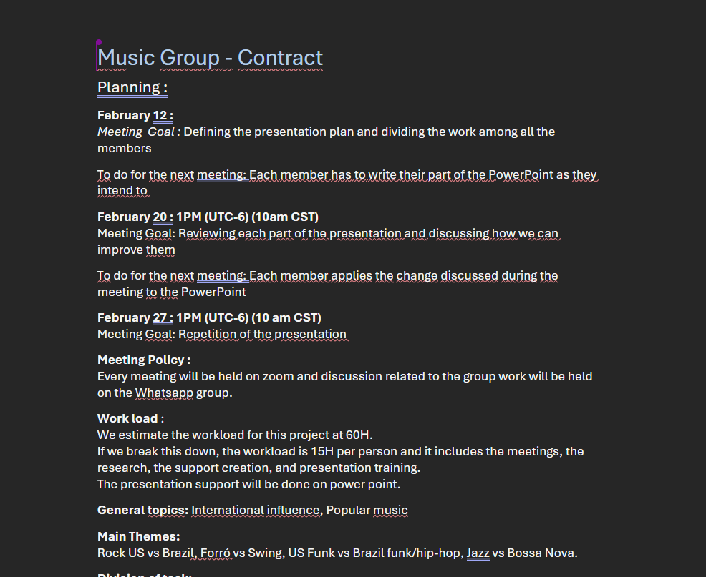
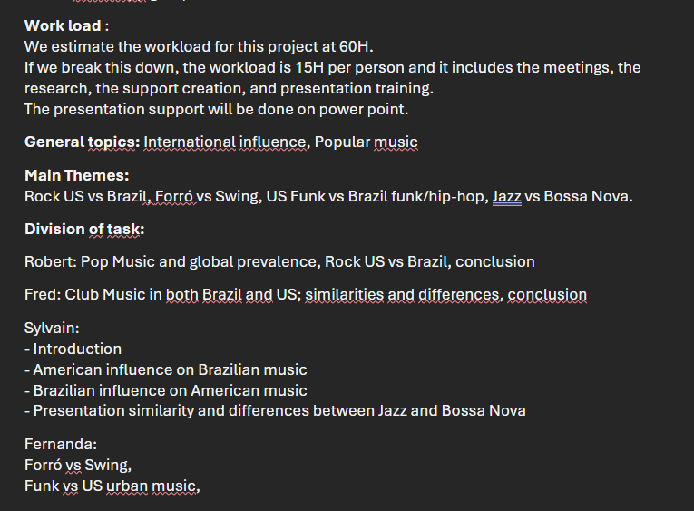
Group Contract

